Slide 1
Homework 2
Luke Roe

Slide 2
1)
The time complexity of k-means is
O(n * k * i * d)
where n is the number of samples, k is the number of clusters, i is the number of iterations, and d is the number of features. This is because the algorithm must compare each centroid in each dimension with every single point every iteration to calculate the distance.

Slide 3
1)
The time complexity of bisecting k-means is
O((k-1)i * n)
where k is the number of clusters and i is the number of iterations and n is the number of samples.

Slide 4
2) Normal K-Means
MinMaxScaler: 0.7946577629382304
StandardScaler: 0.7100723427935448
Raw Data: 0.7440178074568725
MinMax Scalar performs with the greatest accuracy with normal k-means

Slide 5
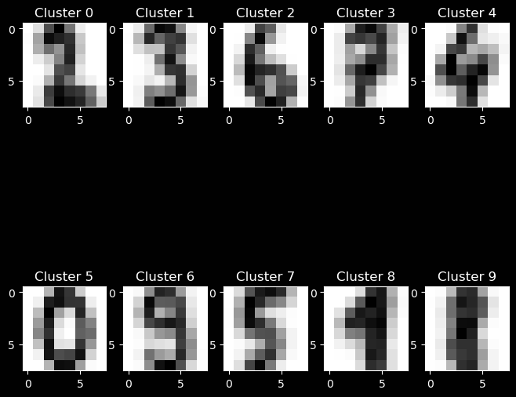
2)

Slide 6
2) Bisecting K-Means
MinMaxScaler: 0.7250973845297718
StandardScaler: 0.6076794657762938
Raw Data: 0.7111853088480802
Once again MinMax Scalar performs with the greatest accuracy with bisecting k-means, however, overall normal k-means performs better than bisecting k-means.

Slide 7
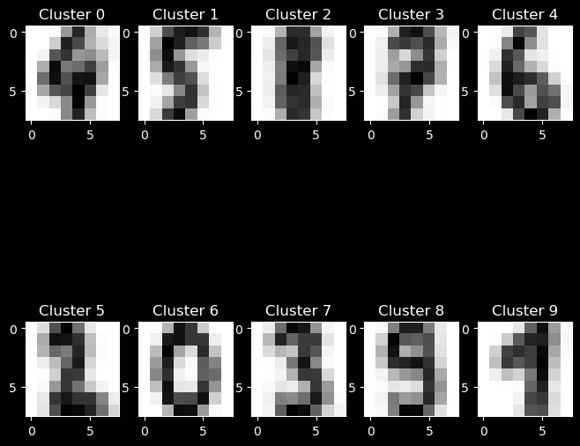
2)

Slide 8
3) Vehicles data
Kmeans with MinMaxScaler: 0.6692506459948321
Kmeans with StandardScaler: 0.661498708010336
Kmeans with Raw Data: 0.6201550387596899
Again, the best results are with the MinMax Scalar however, we can now see the raw data has the worst performance

Slide 9
3)
Next, I removed the `model` column since it has little effect on the classification of the vehicle. I attained better results this way.
Kmeans with MinMaxScaler and no Model: 0.7080103359173127
Kmeans with StandardScaler and no Model: 0.6847545219638242
Kmeans with Raw Data and no Model: 0.6201550387596899

Slide 10
4) Iris
Kmeans with MinMaxScaler: 0.88
Kmeans with StandardScaler: 0.8333333333333334
Kmeans with Raw Data: 0.8866666666666667
Surprisingly, I got the best results with the raw, un-normalized data, although the difference is marginal.

Slide 11
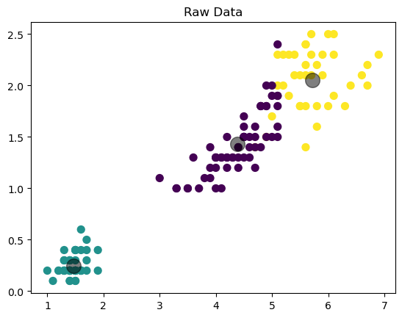
4)

Slide 12
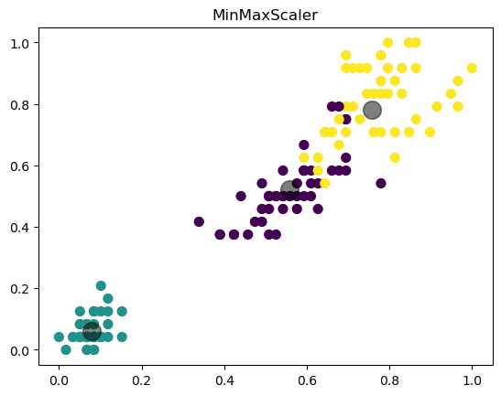
4)

Slide 13
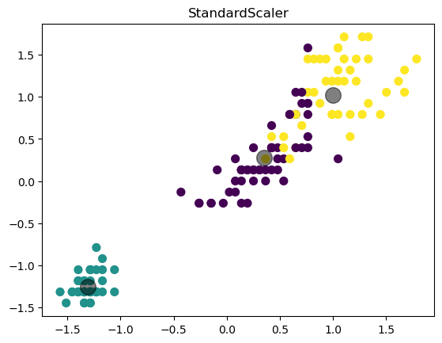
4)

Slide 14
5) Extra Credit
Custom K-means
Steps
1. Pick k random points as the initial centroids
2. Assign each point to the nearest centroid using cosine distance
3. Update the centroids
4. Iterate until the centroids do not change or max iterations reached

Slide 15
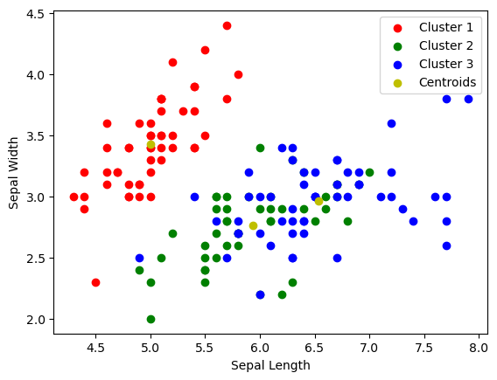
5) Predicted Clusters

Slide 16

5) Ground-truth Labels
mislabeled
Accuracy:
0.9733333333333334

Slide 17
5) Time to Converge
Custom time to converge: 0.017200946807861328
sklearn time to converge: 0.0018837451934814453
Although it has lower accuracy, the sklearn implementation takes around 1/10th the time to complete even with resolve mapping making it far more suitable for larger datasets.

